Slide 1

CM 2602 - Artificial Intelligence
INTRODUCTION TO ARTIFICIAL INTELLIGENCE

Slide 2
Tentative Schedule (2023)
Week Number | Lecture
1 | Introduction to AI, it’s branching and History
2 | Searching Strategies in AI Systems - I
3 | Searching Strategies in AI Systems - II
4 | Constraints Satisfaction
5 | Planning, Ethical and Professional Issues in AI
6 | Engagement Week
7 | Cognitive Computing Overview
8 | Ontology Engineering - Hands On
9 | SPARQL and Reasoning in an Ontology
10 | Knowledge Representation – Prepositional / First Order
11 | Multi Agent Systems - I
12 | Multi Agent Systems - II
 | Revision

Slide 3
Essential Reading List
Russell, S. and Norvig, P. 2010. Artificial Intelligence: A Modern Approach. 3rd ed. Prentice Hall.
Luger, G.F. 2009. Artificial Intelligence: Structures and Strategies for Complex Problem Solving. 6th ed. Addison Wesley.
Millington, I. 2019. Artificial Intelligence for Games. 3rd ed. CRC Press.
Bourg, D. 2004. AI for Game Developers: Creating Intelligent Behaviour in Games. O’Reilly.
Buckland, M. 2004. Programming Game AI by Example.
Wordware Publishing.

Slide 4
Learning Outcomes
Describe intelligent problem-solving methods and their applications underpinned by AI's philosophical and cognitive theory.
Compare and contrast reasoning and knowledge representation strategies used in Artificial Intelligence.
Identify, contrast and apply suitable search techniques related to AI problem solving.
Analyse legal, ethical, and professional issues in the context of intelligent systems solutions for real-world applications.

Slide 5
Assessment
Assessment Method
Weighting
Outcomes Assessed
Description
Final Examination
60%
1, 2
Closed book examination
Individual Coursework
Coursework
40%
3, 4

Slide 6

Contact Information
nipuna.s@iit.ac.lk

Slide 7

<

Slide 8
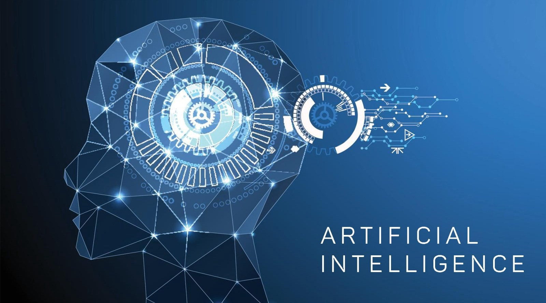

Slide 9
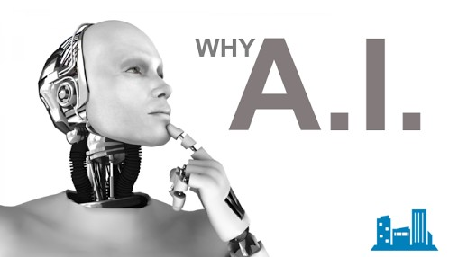

Slide 10


Slide 11


Slide 12


Slide 13
What do we need?

Slide 14
We need intelligent machines !

Slide 15
We need intelligent machines !
Think, Analyze and Make Decisions.

Slide 16
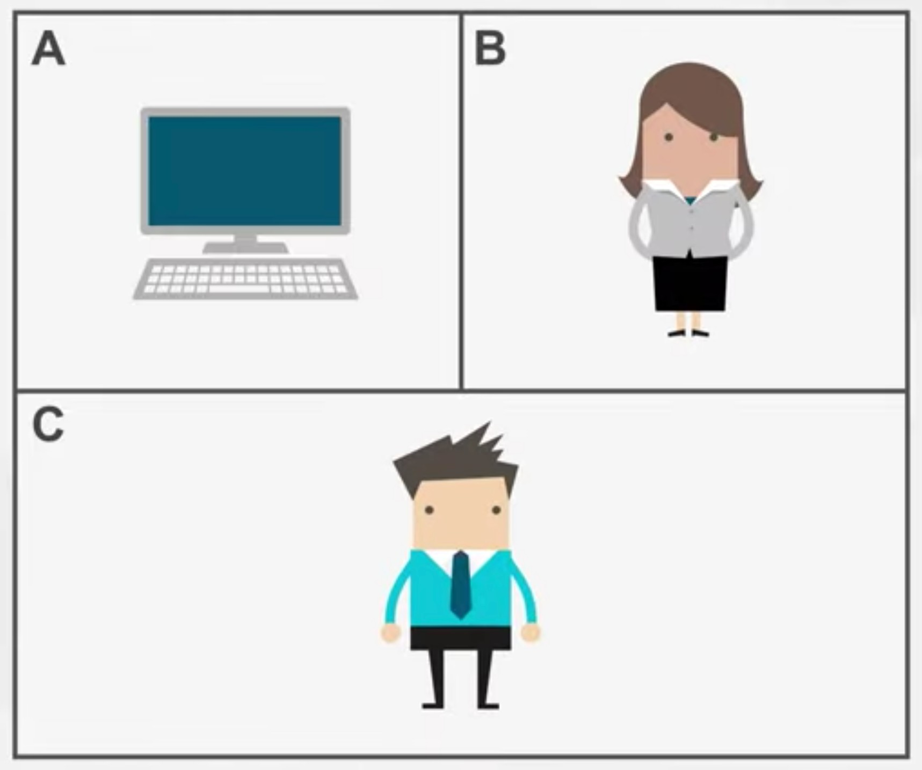
Turing test (Alan Turing, 1950)

Slide 17
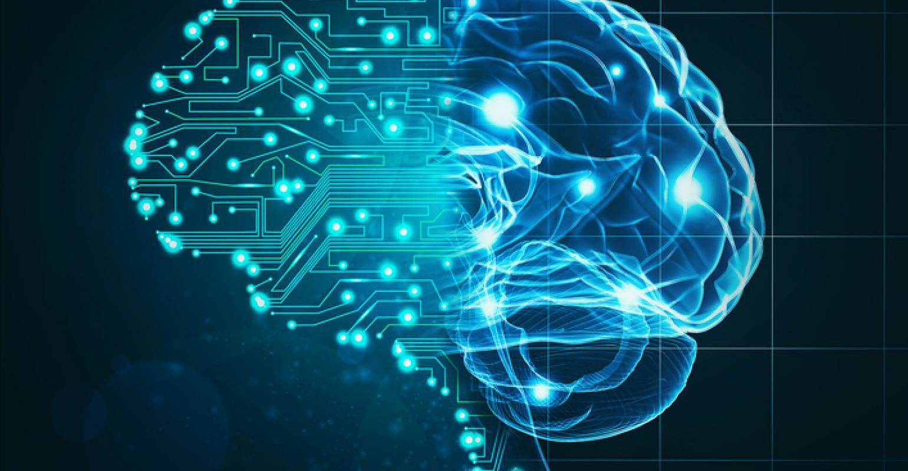
What is Artificial Intelligence?
The science of making machines that can think and act like a humans.

Slide 18




Sub Fields of Artificial Intelligence
Language Understanding
Knowledge Representation
Machine Learning
Knowledge Reasoning

Slide 19
The Roots of Artificial Intelligence
Artificial Intelligence has identifiable roots in a number of older disciplines, particularly:
Philosophy
Logic/Mathematics
Computation
Psychology/Cognitive Science
Biology/Neuroscience
Evolution

Slide 20
AI Has Successfully Been Used in:
Finance
Robotics
Games
Medicine
The Web
and many more…

Slide 21
History of AI
1940-1950: Early days
o1943: McCulloch & Pitts: Boolean circuit model of brain o1950: Turing's “Computing Machinery and Intelligence”
1950—70: Excitement: Look, Ma, no hands!
o1950s: Early AI programs, including Samuel's checkers program, Newell & Simon's Logic Theorist, Gelernter's Geometry Engine
o1956: Dartmouth meeting: “Artificial Intelligence” adopted o1965: Robinson's complete algorithm for logical reasoning
1970—90: Knowledge-based approaches
o1969—79: Early development of knowledge-based systems o1980—88: Expert systems industry booms
o1988—93: Expert systems industry busts: “AI Winter”
1990—: Statistical approaches
oResurgence of probability, focus on uncertainty oGeneral increase in technical depth
oAgents and learning systems… “AI Spring”?
2021—: Where are we now?

Slide 22





What AI can do at present?
Win against any human at chess?
Grab a particular cup and put it on a shelf?
Write an intentionally funny story?
Drive safely in the first street of Pattah?

